Slide 1
Optical sources
Arpita howlader
Dept of Computer & Communication Engineering
Patuakhali Science and Technology University

Slide 2
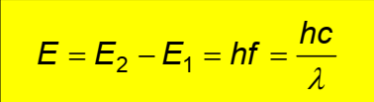
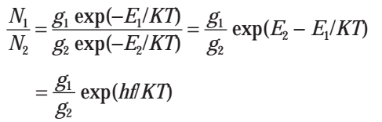


Optical sources 1: the laser
Absorption and Emission of light : The frequency and the wavelength of the emitted or absorbed photon is related to the difference in energy E, between the two energetic states, where h is the Planck constant h=6.626 x 10⁻³⁴ J, f is the frequency and λ is wavelength of the absorbed or emitted light
Einstein relations: The population of the two energy levels of such a system is described by Boltzmann statistics which give:
where N1 and N2 represent the density of atoms in energy levels E1 and E2, respectively, with g1 and g2 being the corresponding decay of the levels, where K= 1.381 × 10⁻²³ J. K⁻¹ is Boltzmann’s constant and T is the absolute temperature.
When decay of the two levels are equal (g1 = g2), then the probabilities of absorption and stimulated emission are equal.

Slide 3


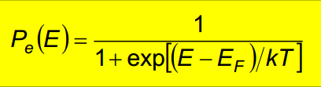
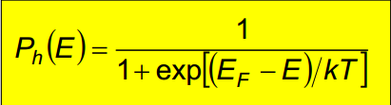
The pn-junction
The Fermi level is a measure of the distribution of carriers in the semiconductor.
Consequently, the probability P(E) that an electron gains sufficient thermal energy at an absolute temperature T, such that it will be found occupying a particular energy level E, where K= 1.381 × 10−23 is Boltzmann’s constant and EF is known as the Fermi energy or Fermi level.
The Fermi level can be seen as a probability function, which describes whether the bands are occupied or not.
The probability that a state is occupied by an electron or hole is exact 50% for the Fermi energy. Fermi-Dirac Distribution
Fermi-Dirac Distribution for Electrons Fermi-Dirac Distribution for Holes

Slide 4
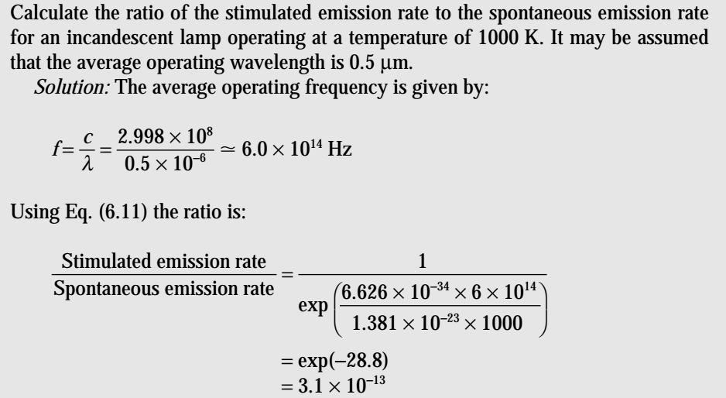
Optical sources 1: the laser
Speed of light, C = 2.998 × 10⁸ or 3.00 × 10⁸ m/s
Planck constant, h = 6.626 × 10⁻³⁴ J
Boltzmann’s constant, K = 1.381 × 10⁻²³ J. K⁻¹

Slide 5

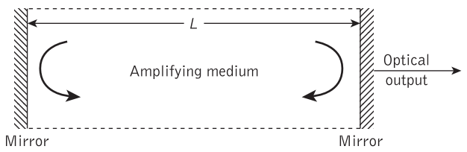


Optical sources 1: the laser
Since the structure forms a resonant cavity, when sufficient population inversion exists in the amplifying medium the radiation builds up and becomes established as standing waves between the mirrors.
These standing waves exist only at frequencies for which the distance between the mirrors is an integral number of half wavelengths.
Thus when the optical spacing between the mirrors is L, the resonance condition along the axis of the cavity is given by :
where λ is the emission wavelength, n is the refractive index of the amplifying medium and q is an integer. Alternatively, discrete emission frequencies f are defined by:
where c is the velocity of light.

Slide 6
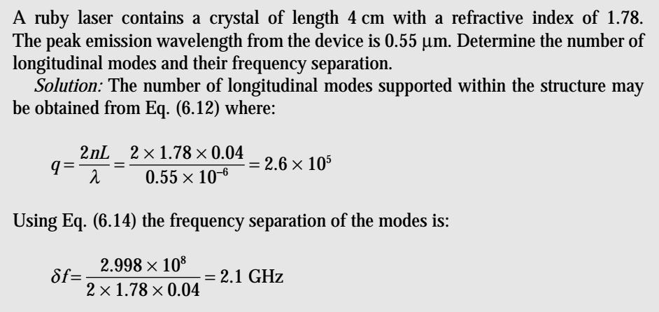
Optical sources 1: the laser

Slide 7




Optical sources 1: the laser
There are a number of ways in which the operational efficiency of the semiconductor laser may be defined.
If Pe is the optical power emitted from the device, I is the current, e is the charge on an electron and hf is the photon energy
The total efficiency (external quantum efficiency) ηT which is efficiency defined as:
where Eg is the band gap energy expressed in eV. The external power efficiency of the device (or device efficiency) ηep in converting electrical input to optical output is given by:
where P = IV is the d.c. electrical input power. V is voltage applied to the device .
Total efficiency we find:

Slide 8
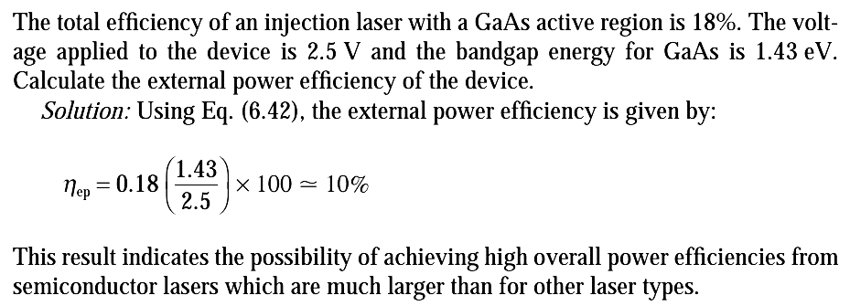
Optical sources 1: the laser

Slide 9









Optical sources 2: the light-emitting diode
The internal quantum efficiency for the LED is obtained only from the spontaneous radiation .
Total number of carrier recombination per second or the recombination rate rt , where is the radiative recombination rate per unit volume and rn is the nonradiative recombination rate per unit volume.
The excess minority carrier density decays exponentially with time t , the radiative minority carrier lifetime is τr = Δn/rr and the nonradiative minority carrier lifetime is τnr = Δn/r. , So Total recombination lifetime τ
Optical power generated internally by the LED, where I is forward-biased current into the device and e is the charge on an electron .

Slide 10
Optical sources 2: the light-emitting diode
Example 7.1 : The radiative and nonradiative recombination lifetimes of the minority carriers in the active region of a double-heterojunction LED are 60 ns and 100 ns respectively. Determine the total carrier recombination lifetime and the power internally generated within the device when the peak emission wavelength is 0.87 μm at a drive current of 40 mA.

Slide 11
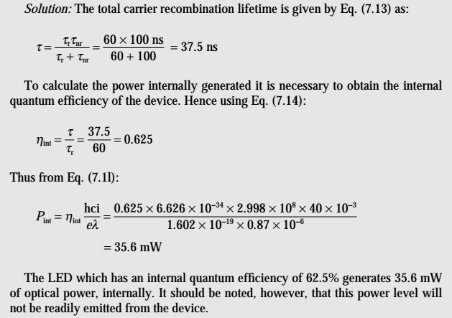
Optical sources 2: the light-emitting diode
Solution 7.1 :

Slide 12



Optical sources 2: the light-emitting diode
The injection laser the external power efficiency ηe is defined as the ratio of the optical power emitted externally Pe to the electric power provided to the device P
Where P = IV is the d.c. electrical input power. V is voltage applied to the device .
The optical power emitted Pe into a medium of low refractive index n from the face of a planar LED fabricated from a material of refractive index n is given approximately by
Again OR
where is the power generated internally and F is the transmission factor of the semiconductor–external interface. Hence it is possible to estimate the percentage of optical power emitted

Slide 13
Optical sources 2: the light-emitting diode
Example 7.2 : A planar LED is fabricated from gallium arsenide which has a refractive index of 3.6. (a) Calculate the optical power emitted into air as a percentage of the internal optical power for the device when the transmission factor at the crystal–air interface is 0.68. (b) When the optical power generated internally is 50% of the electric power supplied, determine the external power efficiency.
Solution: (a) The optical power emitted is given by equation in which the refractive index n for air is 1

Slide 14
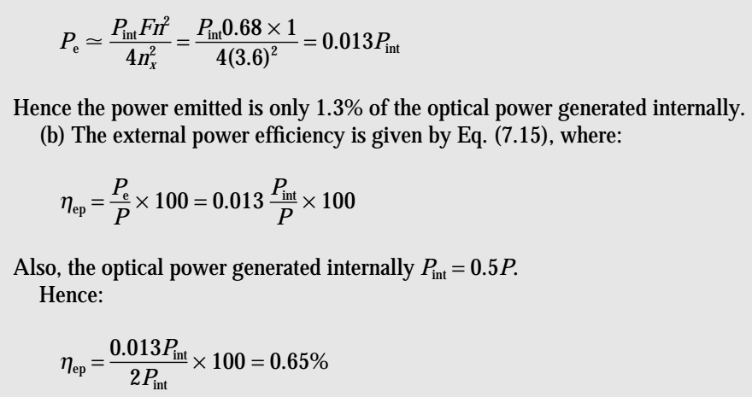
Optical sources 2: the light-emitting diode
Solution: (a) The optical power emitted is given by equation in which the refractive index n for air is 1

Slide 15
Optical sources 2: the light-emitting diode
Example 7.3: The light output from the GaAs LED of Example 7.2 is coupled into a step index fiber with a numerical aperture of 0.2, a core refractive index of 1.4 and a diameter larger than the diameter of the device. Estimate: (a) The coupling efficiency into the fiber when the LED is in close proximity to the fiber core. (b) The optical loss in decibels, relative to the power emitted from the LED, when coupling the light output into the fiber. (c) The loss relative to the internally generated optical power in the device when coupling the light output into the fiber when there is a small air gap between the LED and the fiber core.

Slide 16
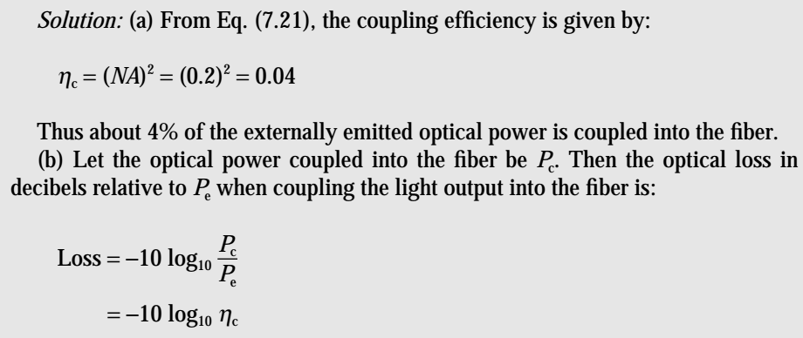
Optical sources 2: the light-emitting diode
Solution 7.3:

Slide 17
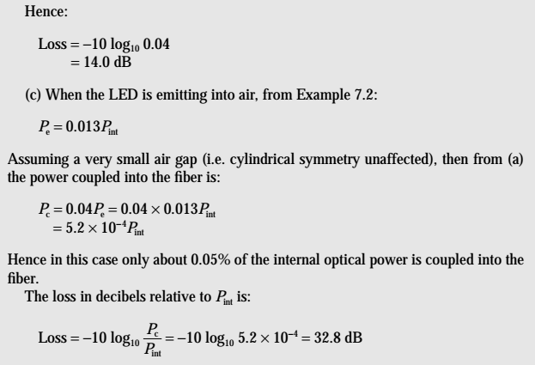
Optical sources 2: the light-emitting diode

Slide 18
THANKS
END

